Slide 1
LEAD SCORE CASE STUDY
DONE BY: ATHIRA SABU

Slide 2
PROBLEM STATEMENT
An education company named X Education sells online courses to industry professionals.
X Education gets a lot of leads, but its lead conversion rate is very poor. For example, if, they
acquire 100 leads in a day, only about 30 of them are converted.
To make this process more efficient, the company wishes to identify the most potential leads,
also known as ‘Hot Leads’.
If they successfully identify this set of leads, the lead conversion rate should go up as the sales team will now be focusing more on communicating with the potential leads rather than making calls to everyone

Slide 3
BUSINESS OBJECTIVE
X education wants to identify most promising leads known as hot leads.
For this they want to build a model which identifies hot leads.
Deployment of the model for future use.

Slide 4
SOLUTION METHODOLOGY
Data cleaning and data manipulation.
Check and handle duplicate data.
Check and handle NA values and missing values.
Drop columns, if it contains large amount of missing values and not useful for the analysis. 4.Imputation of the values, if necessary.
5.Check and handle outliers in data.

Slide 5
EDA
Univariate data analysis: value count, distribution of variable etc.
Bivariate data analysis: correlation coefficients and pattern between the variables etc.
Feature Scaling & Dummy Variables and encoding of the data.
Classification technique: logistic regression used for the model making and prediction.
Validation of the model.
Model presentation.
Conclusions and recommendations

Slide 6
DATA MANIPULATION
Total Number of Rows =37, Total Number of Columns =9240.
Unique value features like “Magazine”, “Receive More Updates About Our Courses”, “I agree to pay the amount through cheque”, “Get updates on DM Content", "Update me on Supply Chain Content”, etc. have been dropped.
Removing the “Prospect ID” and “Lead Number” which is not necessary for the analysis.
After checking for the value counts for some of the object type variables, we find some of the features which has no enough variance, which we have dropped, the features are: “Do Not Call”, “What matters most to you in choosing course”, “Search”, “Newspaper Article”, “X Education Forums”, “Newspaper”, “Digital Advertisement” etc.
Dropping the columns having more than 35% as missing value such as ‘How did you hear about X Education’ and ‘Lead Profile’

Slide 7
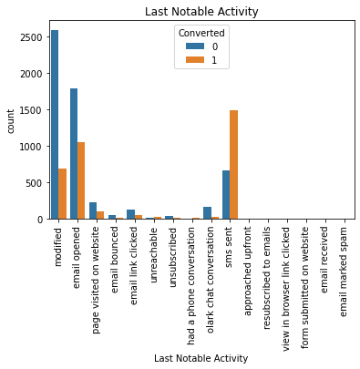
EDA(Exploratory Data Analysis)

Slide 8
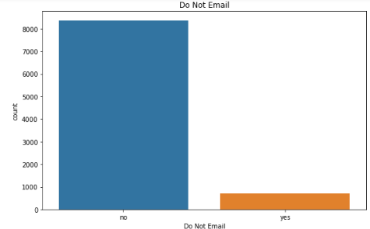
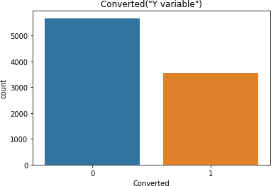
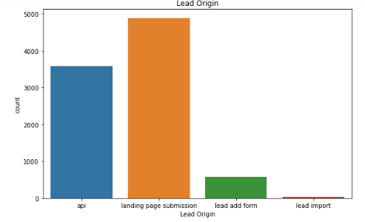

Slide 9
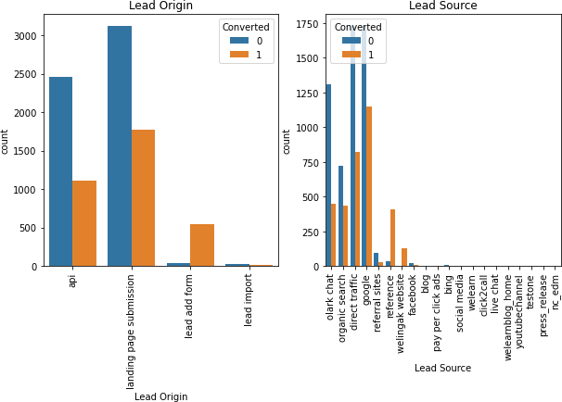
RELATION BETWEEN CATEGORICAL VARIABLES

Slide 10
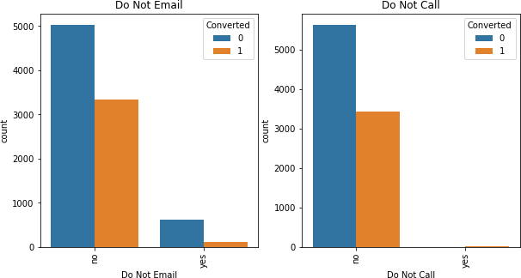

Slide 11
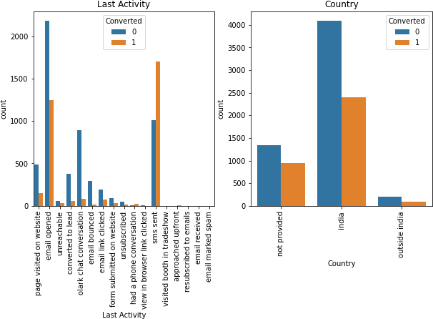

Slide 12
DATA CONVERSION
Numeric variables are normalized.
Dummy variables created for object type variables.
Total rows for analysis:8792
Total columns for analysis:43

Slide 13
MODEL BUILDING
Splitting the Data into Training and Testing Sets
The first basic step for regression is performing a train-test split, we have chosen 70:30 ratio.
Use RFE for Feature Selection
Running RFE with 15 variables as output
Building Model by removing the variable whose p- value is greater than 0.05 and vif value is greater than 5
Predictions on test data set
Overall accuracy 81%.

Slide 14
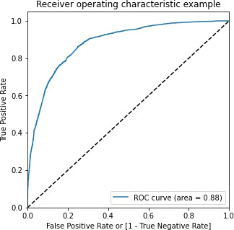
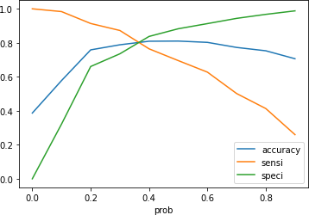
ROC CURVE

Slide 15
Optimal cut off point is the point where we get balanced specificity and sensitivity.
From the second graph it is observed that the optimal cut off is at 0.35.

Slide 16
CONCLUSION
It was found that the variables that mattered the most in the potential buyers are (In descending order) :
The total time spend on the Website.
Total number of visits.
When the lead source was: a. Google b. Direct traffic c. Organic search d. Welingak website
When the last activity was: a.SMS b. Olark chat conversation
When the lead origin is Lead add format.
When their current occupation is as a working professional.
Keeping these in mind the X Education can flourish as they have a very high chance to get almost all the potential buyers to change their mind and buy their courses.

